Slide 1

Sales & Forecast Analysis
Forecast accuracy in 20222

Slide 2
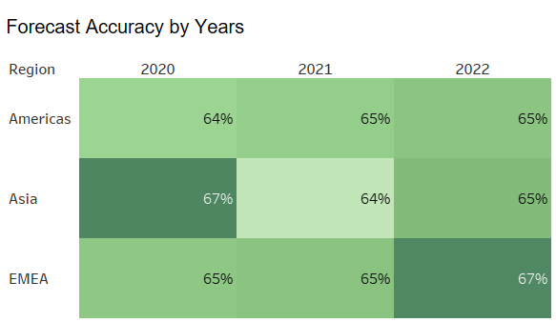
Sales & Forecast Analysis: Overview
Forecast accuracy remained stable around 65% across regions in 2022, with slight improvements in EMEA from to 67%

Slide 3
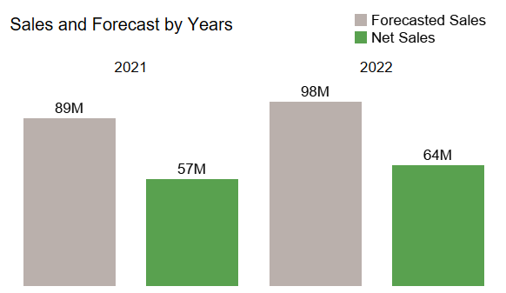
Sales & Forecast Analysis: Asia, 2022
Total Net Sales: 64M
Forecasted Net Sales: 98M
Forecast Accuracy: 65%
Planned YoY growth: 10%
Real YoY growth: 13%

Slide 4
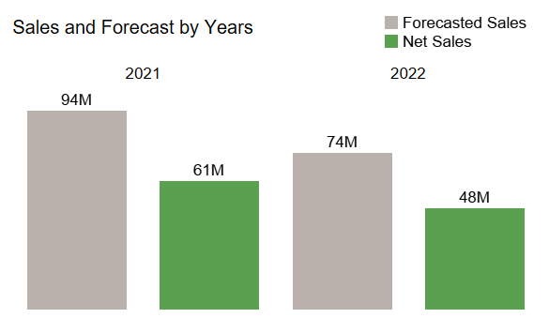
Sales & Forecast Analysis: Americas, 2022
Total Net Sales: 48M
Forecasted Net Sales: 74M
Forecast Accuracy: 65%
Planned YoY decline: -21%
Real YoY decline: -21%

Slide 5
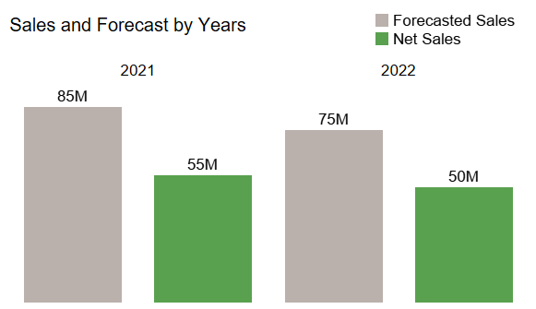
Sales & Forecast Analysis: EMEA, 2022
Total Net Sales: 50M
Forecasted Net Sales: 75M
Forecast Accuracy: 67%
Planned YoY decline: -12%
Real YoY decline: -9%

Slide 6
Sales & Forecast Analysis: Action Points
Enhance Forecasting Models
Targeted Interventions
Continuous Monitoring

Slide 7
Sales & Forecast Analysis: Links
Author: Sofia Shchetinina
Data processing: Github
Dashboard: Tableau

